Slide 1

Investing in Health:
How can the United Kingdom contribute to a grand convergence in global health?
Sir Richard Feachem, KBE, FREng, DSc(Med), PhD
Director, Global Health Group
University of California, San Francisco
October 15, 2015
London, UK

Slide 2
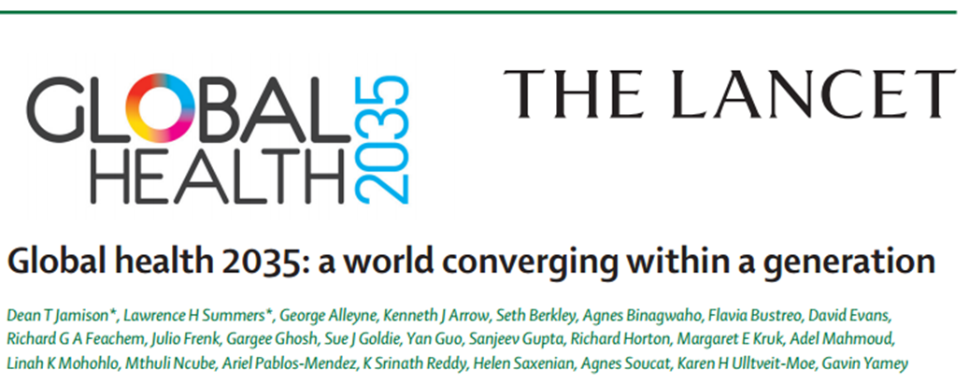
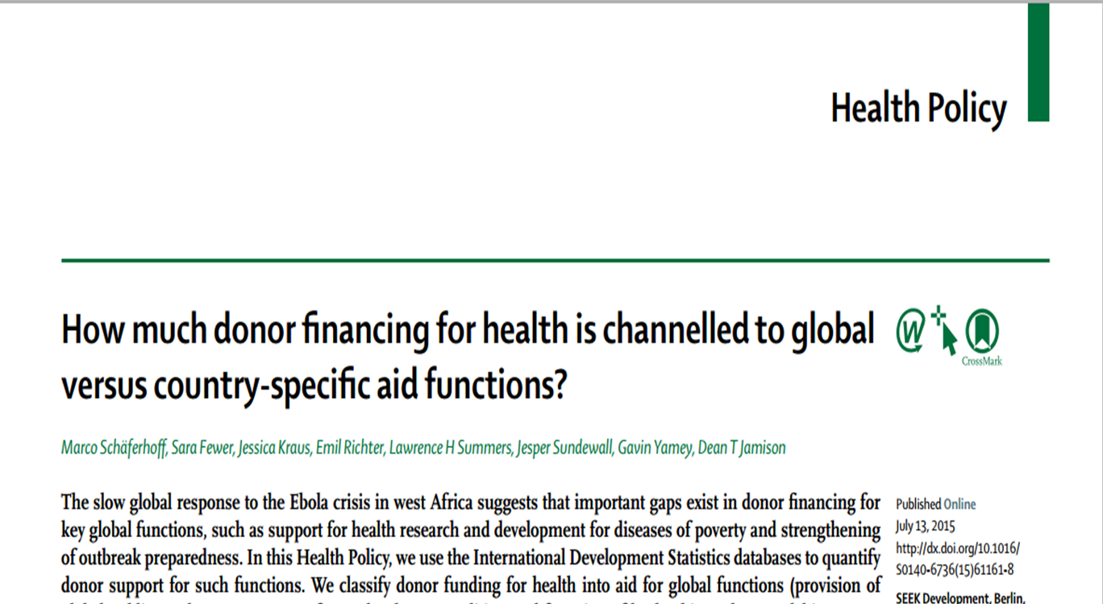
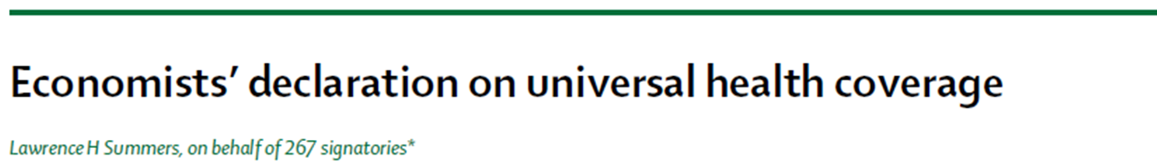

Slide 3
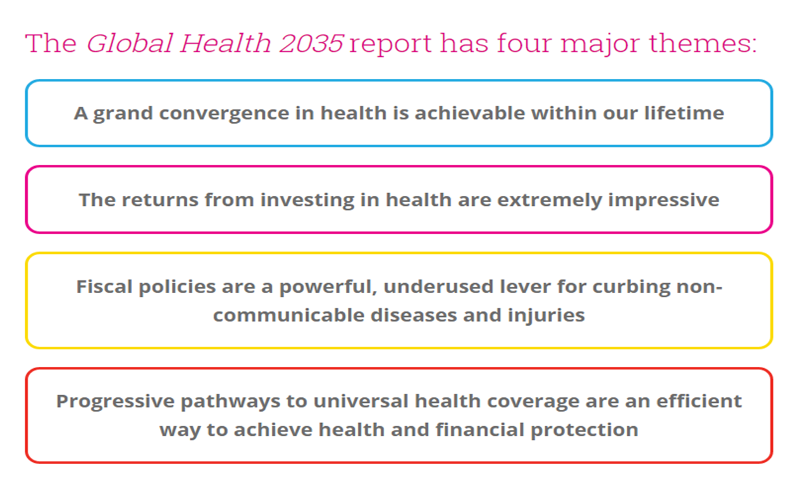
Commission on Investing in Health

Slide 4
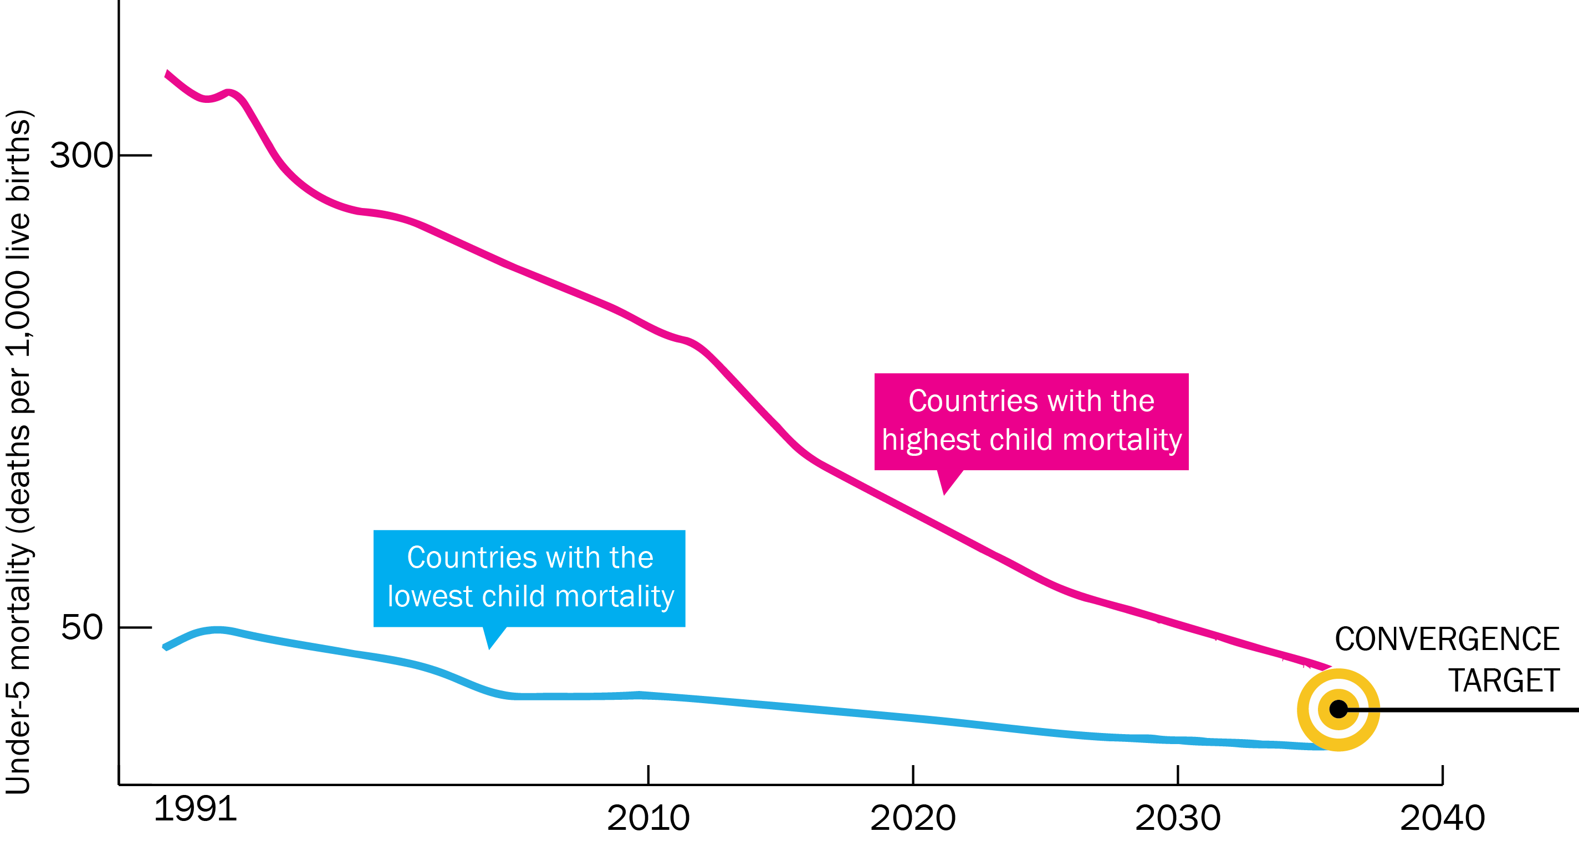
Now on cusp of a historical achievement:
Nearly all countries could converge by 2035

Slide 5
Opportunities for donors to support a grand convergence
Invest in:
Global public goods, especially product development
Tackling antimicrobial resistance and preparing for pandemics
Selected support to middle-income countries for globally coherent strategies (e.g. malaria elimination)
Direct financial support to high burden countries

Slide 6
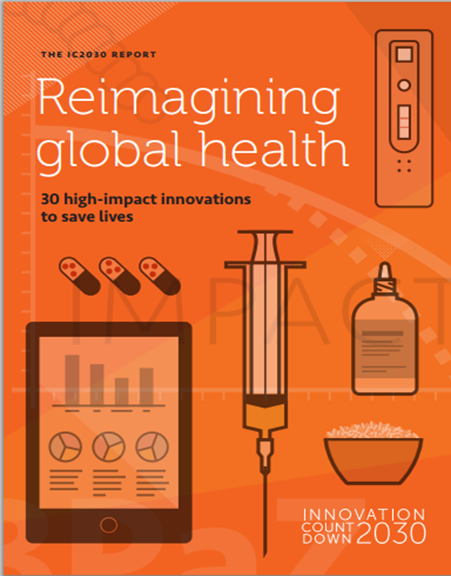
Innovation Countdown 2030
30 High-Impact Innovations to Save Lives
Single-dose, multi-species malaria drug
  A simple treatment that avoids drug resistance
New vaccine to prevent TB
    Potential new protection for adults at risk
Source: PATH, July 2015.

Slide 7
New classification of donor financing for health
Function | Examples
GLOBAL FUNCTIONS
Supplying global public goods (GPGs) | Research and development Knowledge generation and sharing Intellectual property sharing Market shaping activities
Managing cross-border externalities | Outbreak preparedness and response Responses to antimicrobial resistance Polio and malaria elimination
Fostering leadership & stewardship | Health advocacy and priority setting Aid effectiveness and accountability
COUNTRY-SPECIFIC FUNCTIONS
Direct support to low- and middle-income countries | Convergence interventions Non-communicable disease control Health system strengthening

Slide 8
ODA+ for health: A new measure of health aid
Health official development assistance (OECD DAC)
Funding for neglected disease R&D (G-FINDER)
ODA+
Methodology
Assessed the bilateral and multilateral health ODA of 8 donors, 2013 data:
  Australia, France, Germany, the Netherlands, Norway, Sweden, the UK, and the USA (83% of all health ODA)
  Analyzed each project by global and country-specific functions
  Extrapolated results to arrive at a global estimate
Reviewed public spending for pharmaceutical R&D for neglected diseases

Slide 9
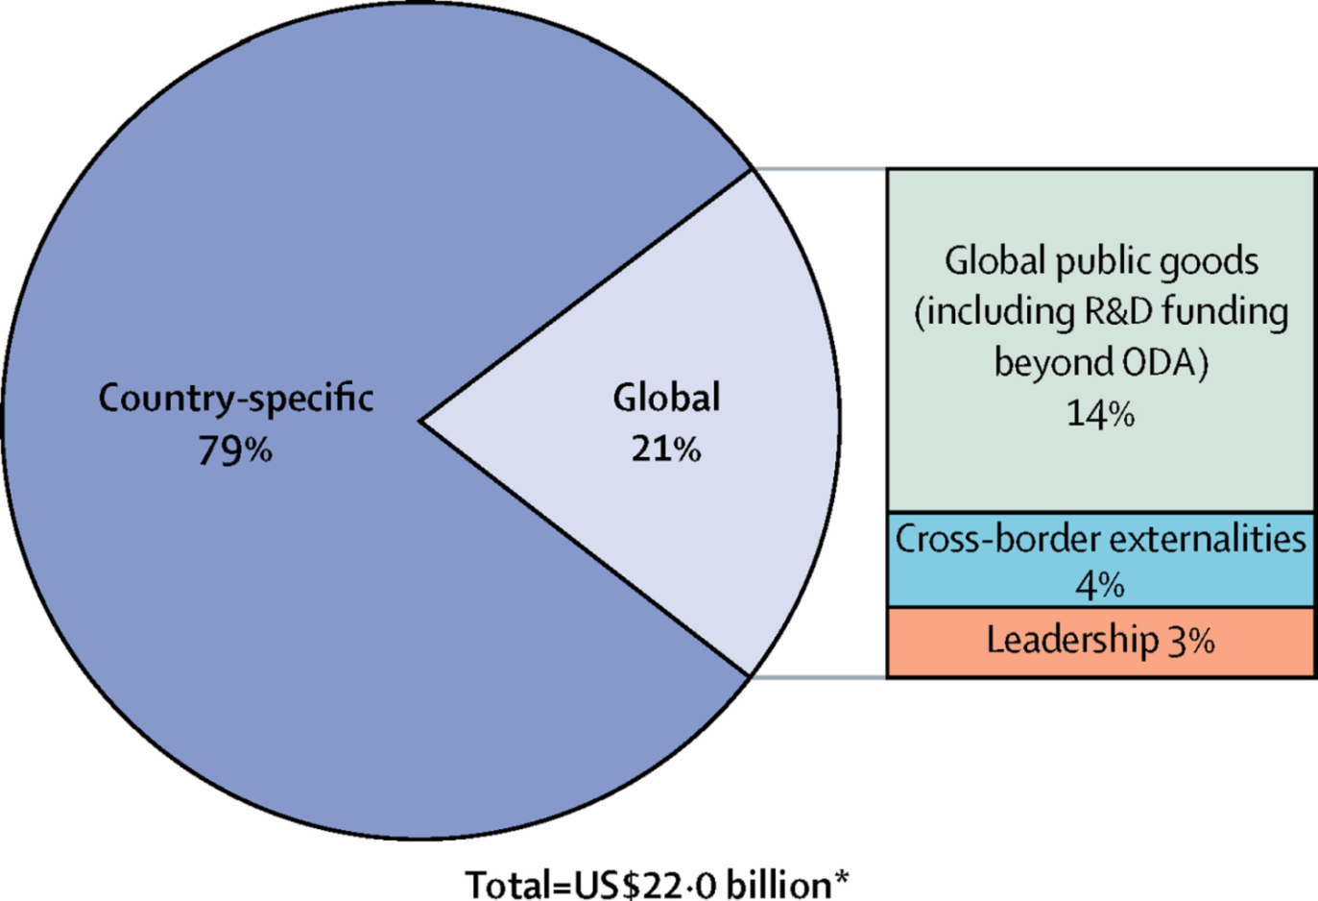
ODA+ for health:
Global vs. country-specific functions
Donor spending for ODA+ for health was $22 billion (USD) in 2013

Slide 10
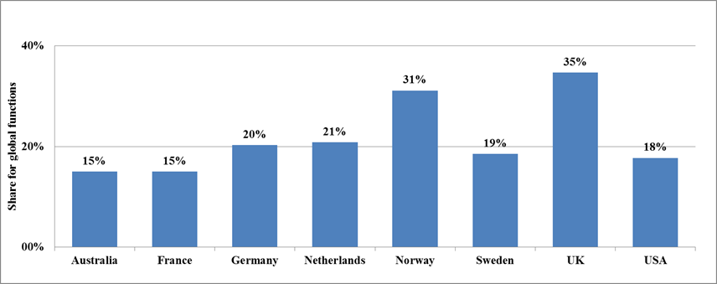
Spending on global functions by eight donors, 2013, as a % of total ODA+ for health

Slide 11
UK ODA+ for health:
Global vs. country-specific functions
UK spending for ODA+ for health was $3.16 billion (USD) in 2013
Global
35%

Slide 12
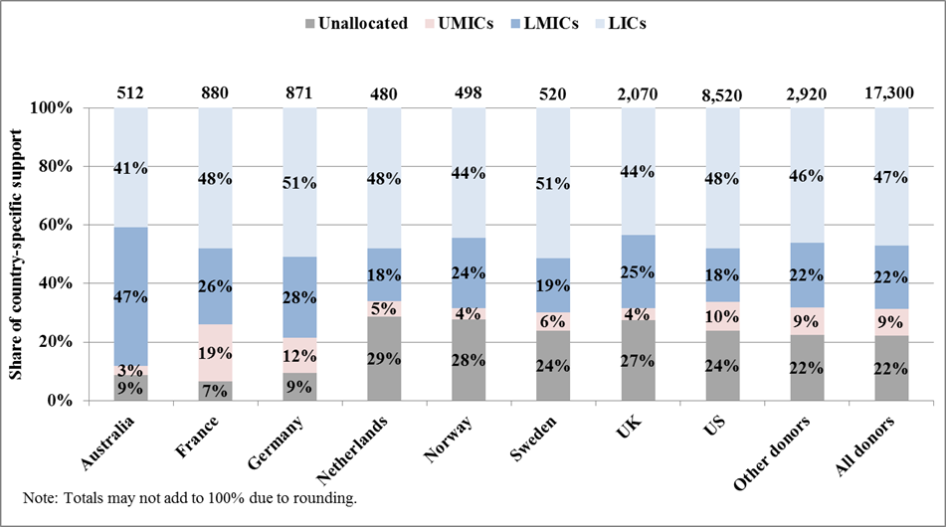
Country-specific support by eight donors,
2013, by country income group

Slide 13
Policy Implications
Strengthen support for global functions.
  Only one-fifth of ODA+ for health is for all global functions.
  As countries graduate from donor support, shift aid towards global functions.
  Efficient way to address “middle-income dilemma.”
Selected support to middle-income countries for globally coherent strategies (e.g. malaria elimination and vulnerable groups).
Support health systems strengthening and innovation (finance and delivery) in the poorest countries.

Slide 14
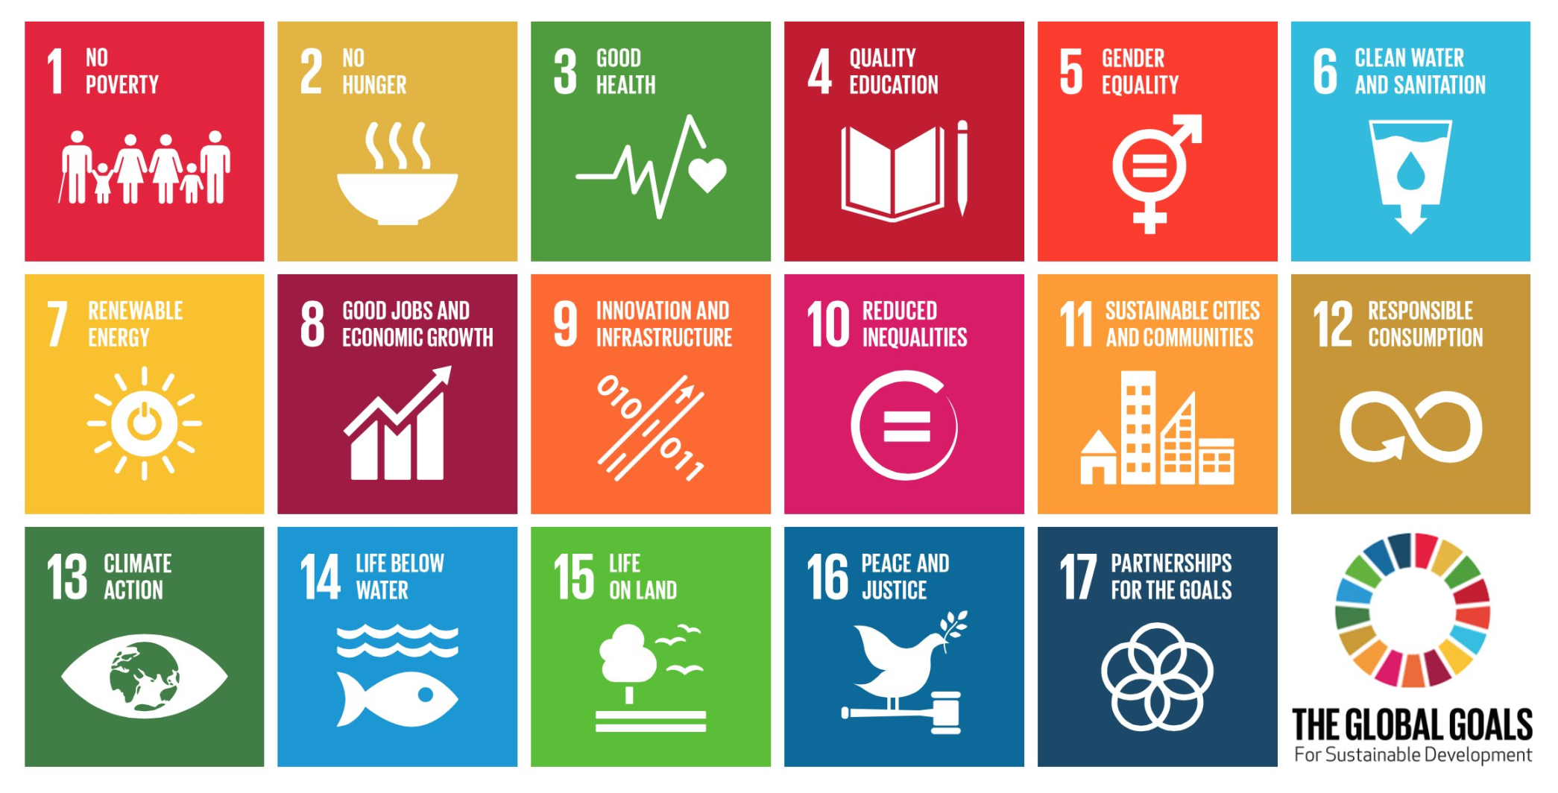
The Global Goals
for Sustainable Development
14

Slide 15

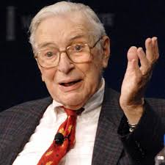
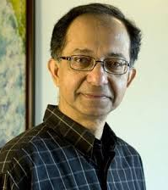
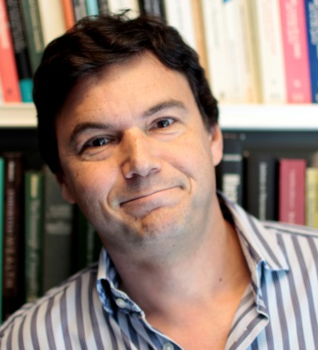
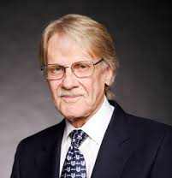
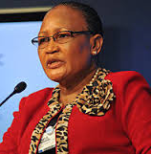
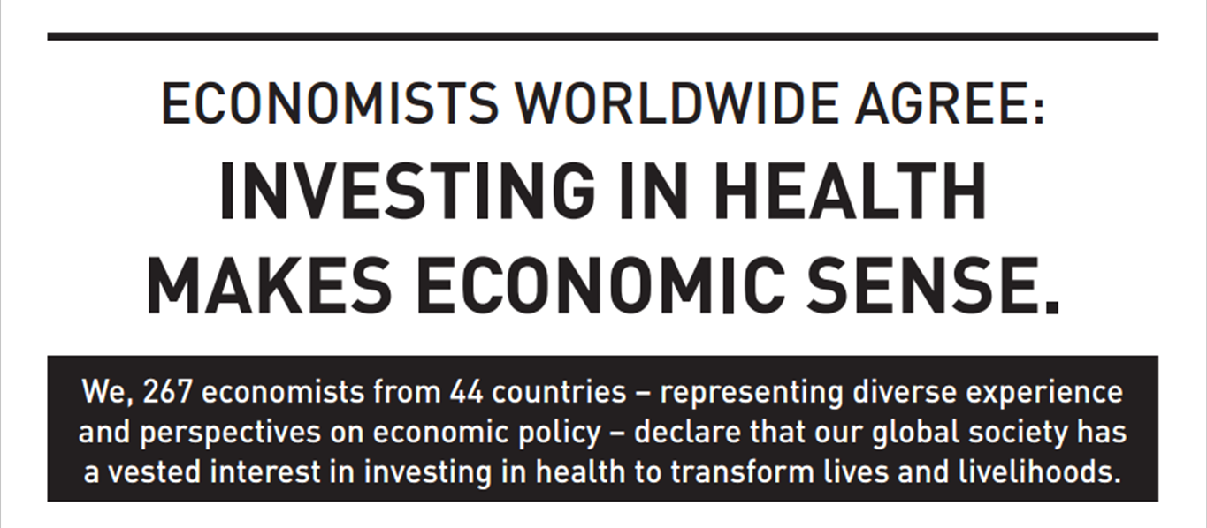
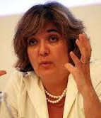

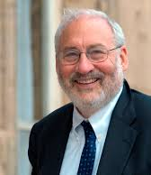
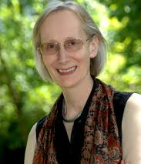
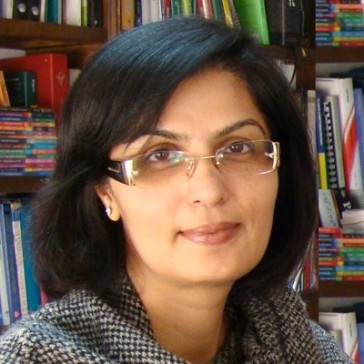
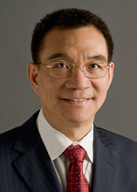
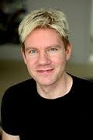
15

Slide 16
Summary of economists’ conclusions
Development assistance for health is essential in achieving a grand convergence and universal health coverage.
Financing global public goods is critical, and is also an efficient path to help the poor in middle-income countries.
Resources will remain highly constrained, but the intrinsic value of improved health points to maintaining and expanding commitment to health.
Source: Economists’ Declaration on Universal Health Coverage, Lancet, Sep 2015.

Slide 17
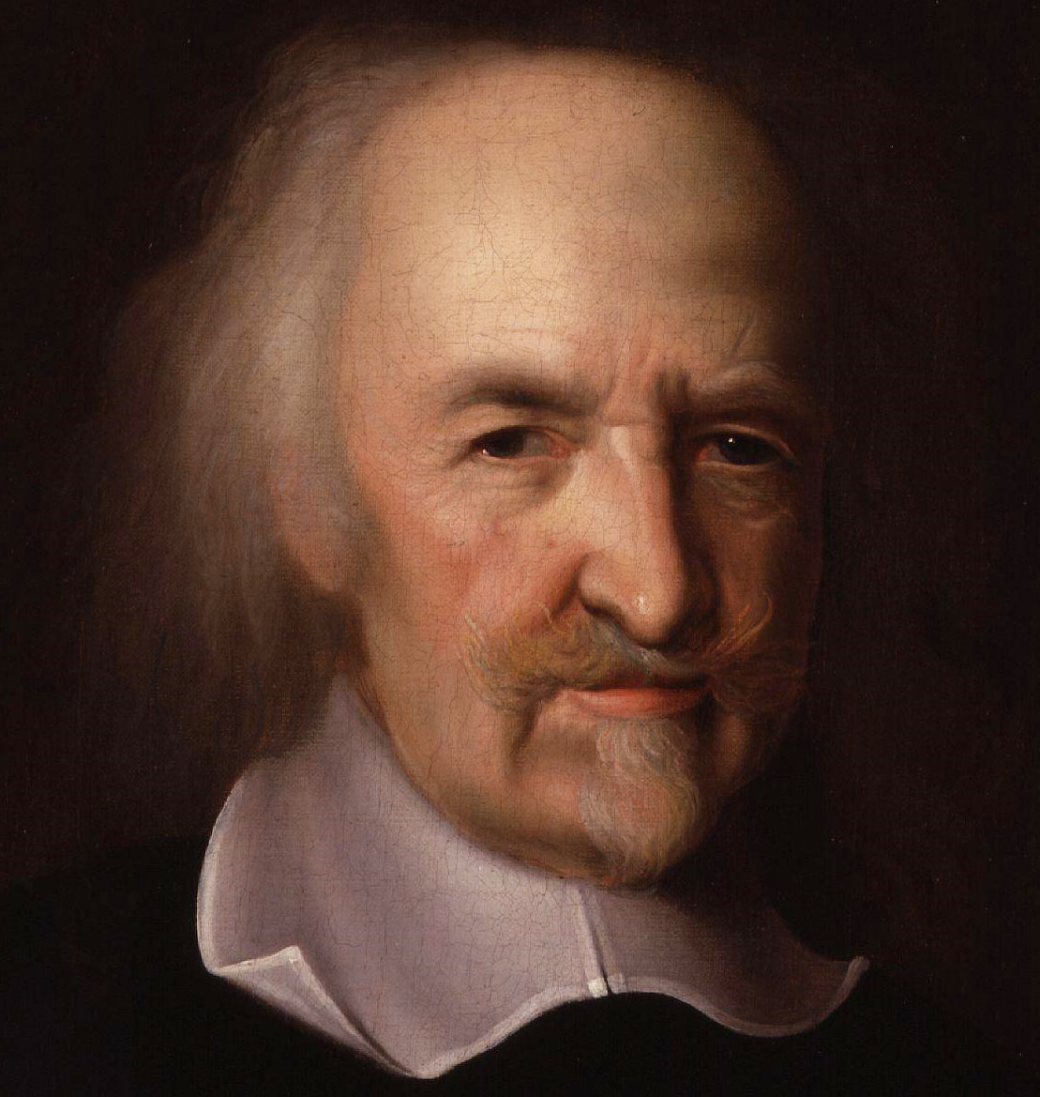
Thomas Hobbes
1651
“The life of man is poor, nasty, brutish and short”
He might have said,
“The life of woman is poor, nasty, brutish, short and pregnant.”

Slide 18
Homo Sapiens
Converged, Diverged, and Converged Again
BC 198,000
1800
Today
2035
99.9%
0.1%
0.01%

Slide 19
Thank you
GlobalHealth2035.org
#GH2035
@globlhealth2035

